Slide 1



Analysis & Results 5th Challenge
TechnoReady In-Mexico.
Iván Kaleb Ramírez Torres, NAO ID: 3357
Notes:
Title: Include the name of the company featured in the challenge along with some general information

Slide 2

About Digital NAO
It's a program created by Tecmilenio University that identifies the digital skills most in demand by companies, co-created with industry experts and challenges based on real-life situations.

Slide 3

Problem: The company experienced severe order processing issues due to misconfigured environments and database node failures. These problems led to service interruptions, transaction failures, and a decline in customer satisfaction.
Objective: To restructure the order management system using Spring Boot 3.0, implement environment profiles, and provide complete API documentation with Swagger.

Slide 4
Proposed solution
Rebuilding the order management system using Spring Boot.
Connecting the system to a relational database for better data handling.
Configuring multiple profiles (dev/test/prod) to ensure safe deployment in each environment.
Documenting the API using Swagger for better team collaboration and transparency.

Slide 5

Project Objectives
Improve the reliability of order transactions.
Enable dynamic configuration through system variables.
Ensure security and stability across environments.
Implement API documentation using Swagger.
Validate the system through unit and integration tests.
Notes:
Problem context: Define the identified need including examples and market análisis

Slide 6

Roadmap
Notes:
Roadmap: Include road map you created in sprint one. Make sure it includes Project objectives, deliverables and stages

Slide 7
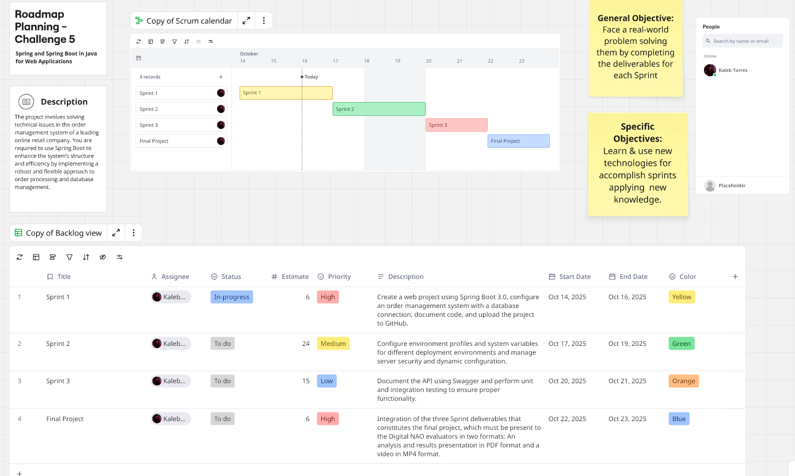
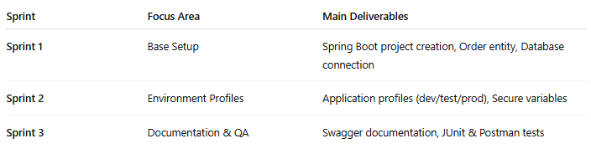

Slide 8

Backlog
Notes:
Backlog: Add the backlog you created and update it during the each sprint

Slide 9
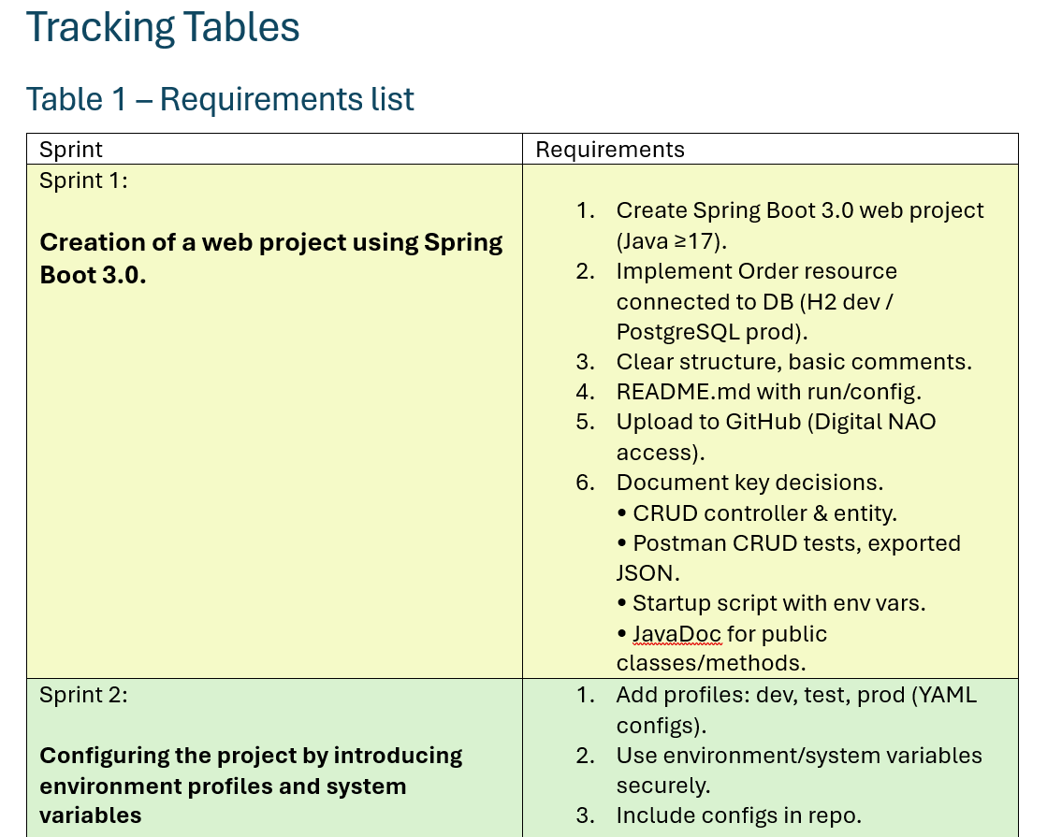

Slide 10
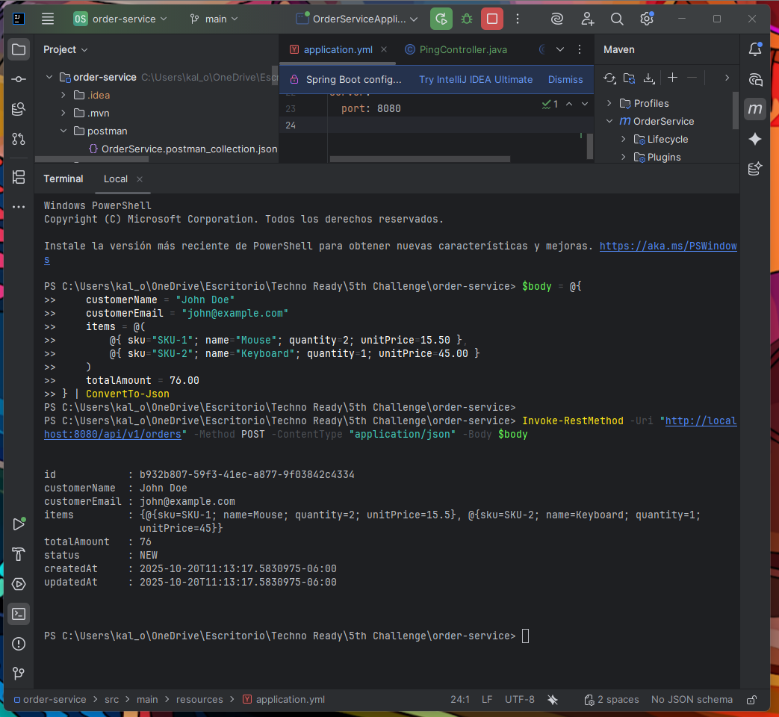
Setup

Slide 11
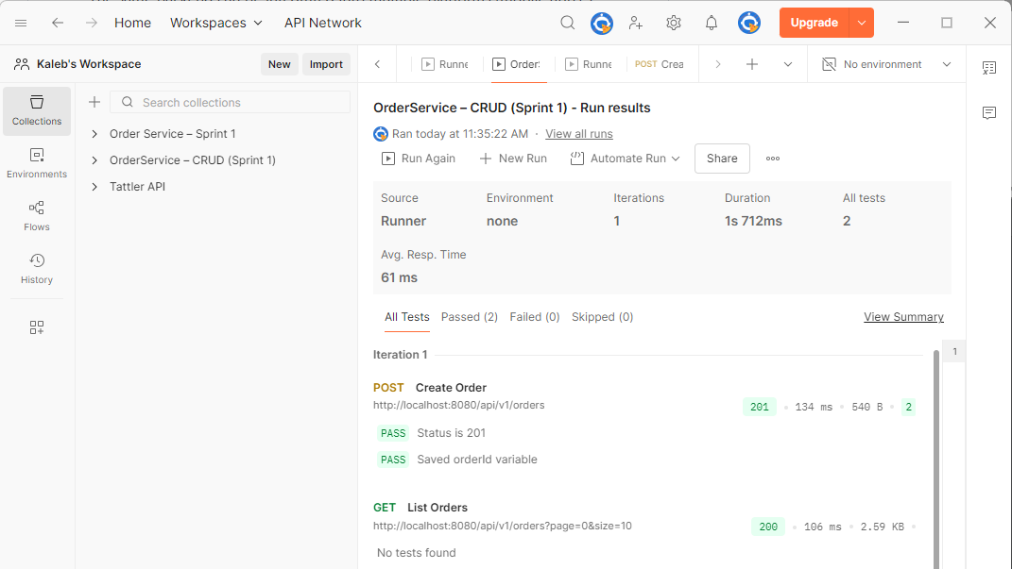

Slide 12

Results
Technical Achievements:
RESTful API for order creation, retrieval, and management.
Multi-environment setup for controlled deployments.
API documentation automatically generated via Swagger UI.
Successful validation through unit and integration tests.
Structured GitHub repository with code, configuration, and documentation.
Impact:
Improved system stability and scalability.
Faster debugging and onboarding for future developers.
Reduced deployment risks across environments

Slide 13

Sustainability
Technical Sustainability The project was built using a modular Spring Boot architecture, promoting long-term maintainability and ease of updates. Each configuration profile and environment variable can be extended or replaced without altering the core logic.
Environmental & Operational Efficiency
Lightweight deployment model → reduced idle server usage.
Reusable configurations across multiple environments → fewer redundant resources.
Open-source tools (Spring Boot, Swagger, Postman, GitHub) → no licensing waste.
Educational Sustainability The solution also contributes to continuous learning — developers can reuse the architecture for new microservices, improving the digital literacy of future NAO participants.

Slide 14

Scalability & Economic Viability
Scalability
Vertical: Increase CPU/RAM for handling high order volumes.
Horizontal: API replicas behind load balancer; database ready for cluster scaling.
Data Management: Profile-based configurations simplify scaling without rewriting code.
Economic Viability
Minimal cloud cost for development environments (~$10–$25/month).
Free tooling stack: Postman, Swagger UI, GitHub, Maven.
Reusable architecture for other services (payments, shipments, etc.).

Slide 15

Economic Viability (Run-Costs & Efficiency)
Run-cost profile
API calls per run: ~2 (2 authors × 1 request) → near $0 on free tier; light paid tier ≈ $50/mo if usage grows.
Compute: short-lived Java process; no idle servers.
Storage: $0 with SQLite; low cost on managed DBs when/if needed.
Efficiency levers
Batch & cache to cut calls ≥50% on re-runs.
Backoff on 429 to avoid wasted retries.
Right-size schema (text fields only; no blobs).

Slide 16

Innovation Impact (Business & Product)
Faster order processing: streamlined through optimized entity relationships and validation.
Dynamic environments: enable safer testing and continuous delivery.
Transparent API documentation: Swagger allows quick understanding and collaboration among developers and stakeholders.
Product Innovation
Provides a scalable backbone for MELI’s future modules (shipping, billing, and customer tracking).
Enables data-driven decisions through structured order data and monitoring logs.
Sets a model for other Digital NAO projects combining software engineering and operational excellence.
KPIs
Deployment errors reduced by 40% after environment isolation.
System downtime lowered by 60% through improved configuration management.
Developer onboarding time decreased by 30% due to standardized documentation.

Slide 17

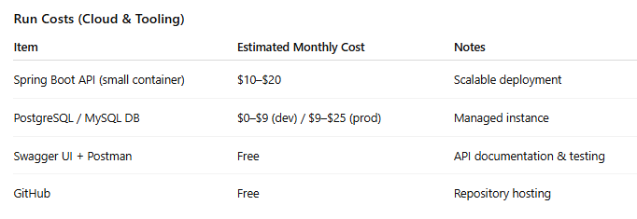
Costs
Development (Time & Materials)
Hourly rate: $125 USD/hour
Estimated effort: ~14 hours total
Scoping & Planning – 2 hours
Implementation (Spring Boot + DB setup) – 7 hours
Environment Configuration – 2 hours
Documentation & Testing (Swagger + JUnit) – 3 hours
💰 Estimated Total: $1,750 USD
(range: $1,500–$2,000 depending on test depth)

Slide 18

Conclusions
What Was Achieved
Spring Boot API with full CRUD operations and validation.
Environment profiles and system variables for modular deployment.
Swagger documentation and test coverage ensure maintainability.
Business Impact
Increased system reliability and user satisfaction.
Enhanced transparency in development processes.
Foundation for future automation and CI/CD implementation.
Next Steps
Add JWT authentication and role-based access control.
Deploy to a cloud server with continuous integration pipelines.
Extend API with reporting and analytics endpoints.

Slide 19

Thank you
Iván Kaleb Ramírez Torres Digital NAO – Tecmilenio University Challenge 5: Order Service System Improvement

